Slide 1
Capstone project on weather analysis

Slide 2
Objectives
1.Understand Historical Weather Patterns: The primary objective is to gain a deeper understanding of historical weather patterns, trends, and variations over the specified time range and geographical areas.
2.Identify Extreme Weather Events: Uncover extreme weather events or anomalies in the dataset, such as heatwaves, cold spells, or heavy storms, to help stakeholders prepare for and respond to such events.
3.Support Decision-Making: Provide actionable insights and recommendations to support decision- makers, including local authorities, urban planners, and meteorologists, in making informed decisions regarding weather-related concerns in the selected regions.

Slide 3
Insights
1.Seasonal Temperature Variations: Analyze temperature data to identify seasonal variations in the selected cities. Determine which regions experience the most significant temperature fluctuations.
2. Correlation Between Wind Speed and Air Pressure: Explore the relationship between wind speed and air pressure, and identify any correlations or patterns that may help in forecasting weather conditions.
3. Humidity Trends Over Time: Examine humidity levels over the specified time range to understand how humidity changes and whether there are any long-term trends or
patterns.
4. Geographical Distribution of Cities: Visualize the geographical distribution of cities based on latitude and longitude. Identify areas with higher concentrations of cities.
5. Comparison of Two Selected Cities: Conduct a detailed comparison of key weather
parameters, such as temperature, humidity, wind speed, or air pressure, between
two specific cities over a defined time frame.

Slide 4
6. Recommendations for Preparedness: Based on the analysis findings, provide recommendations for strategies and measures that stakeholders can take to mitigate the
impact of extreme weather events.
7. Data Visualization for Insights: Create a range of visualizations, including maps, line charts, scatter plots, and heatmaps, to effectively communicate the insights and patterns discovered in the data.

Slide 5
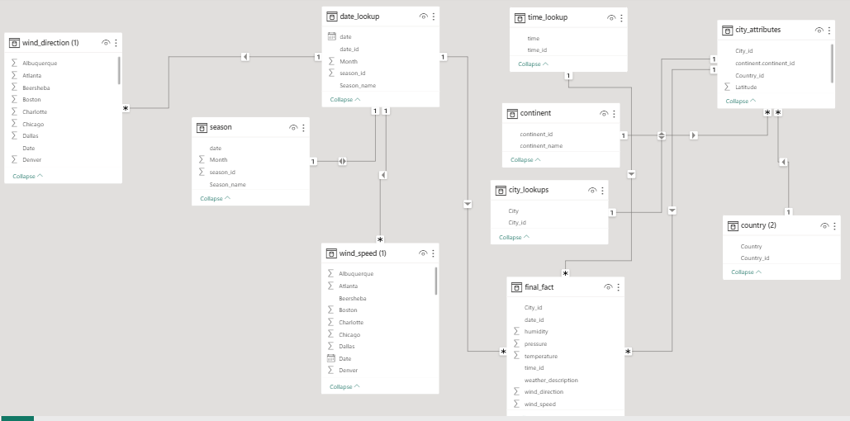
ER DIAGRAM:

Slide 6
POWER BI PROBLEM STATEMENT

Slide 7
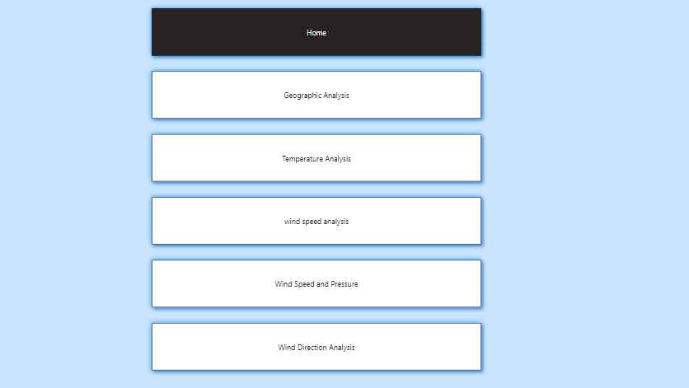

Slide 8
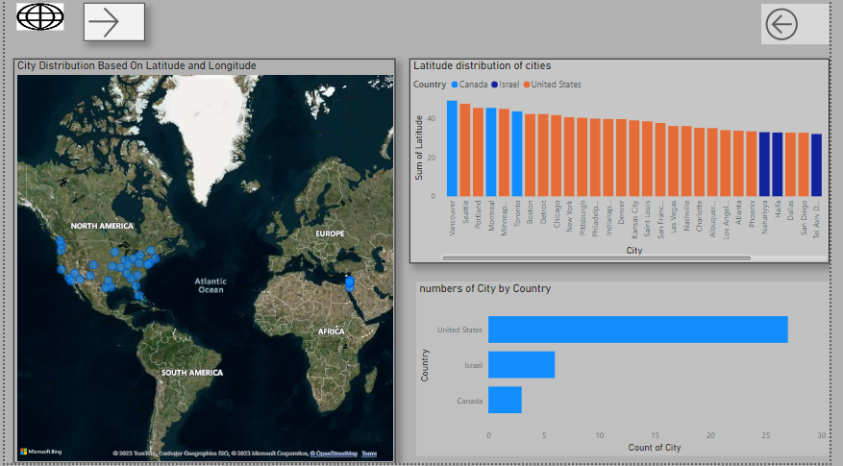
GEOGRAPHICAL ANALYSIS

Slide 9
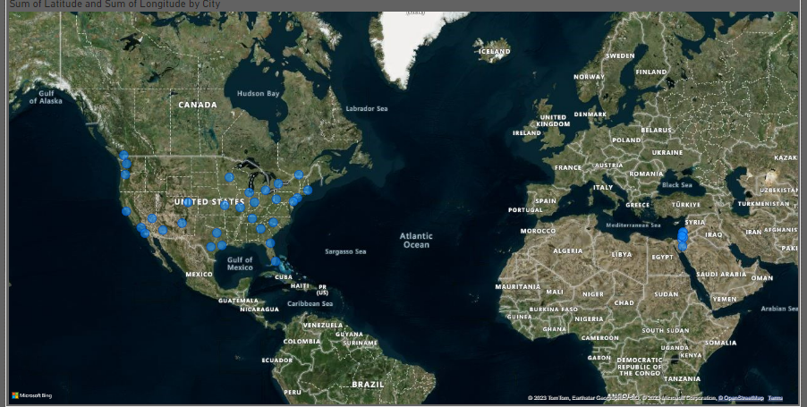
Distribution of cities in the dataset based on their latitude and longitude
New York City is located at a relatively high latitude, meaning that it experiences colder winters and warmer summers than cities located closer to the equator. Los Angeles, on the other hand, is located at a much lower latitude, and therefore has a more Mediterranean climate, with mild winters and dry summers.
Similarly, the longitude of North American cities also affects their climate. For example, cities located on the western side of the continent, such as Vancouver and Los Angeles, tend to be wetter than cities located on the eastern side, such as New York City and Montreal. This is because the prevailing winds in North America blow from west to east, carrying moisture from the Pacific Ocean to the Atlantic Ocean.

Slide 10
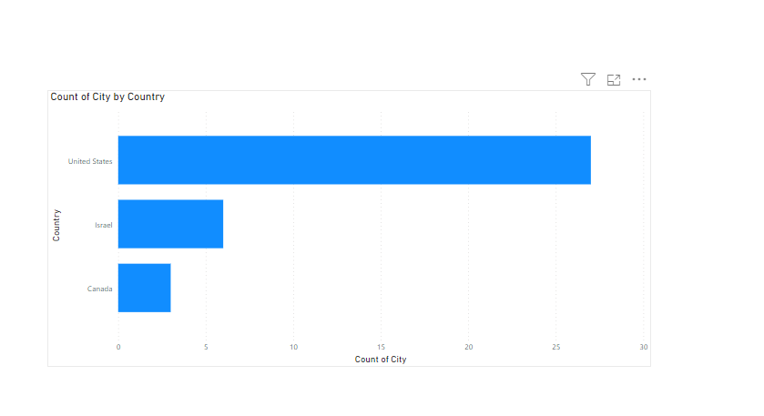
Countries with the highest number of cities in the dataset?
This Chart Is showing the Number of cities based on country.
United State has Maximum number of cities and Canada has the least number of cities

Slide 11
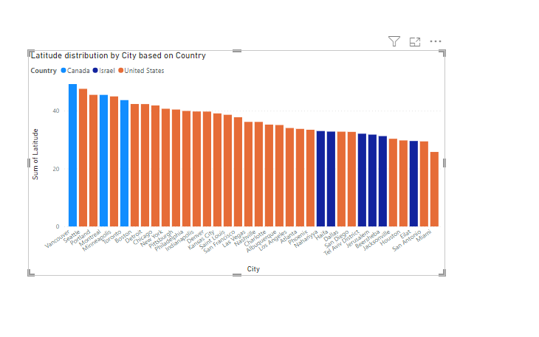
How does the distribution of cities in terms of latitude vary across different Countries
This Chart is showing Latitude Distributions of cities based on country

Slide 12
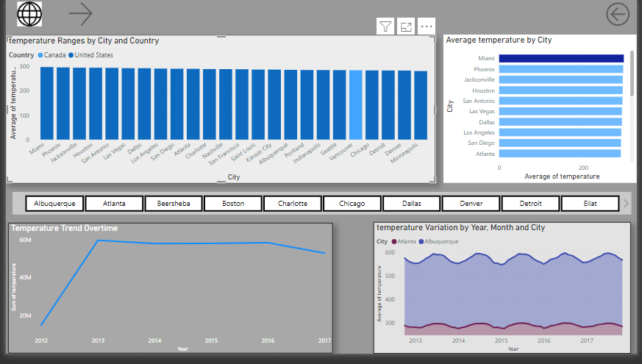
Temperature Analysis

Slide 13
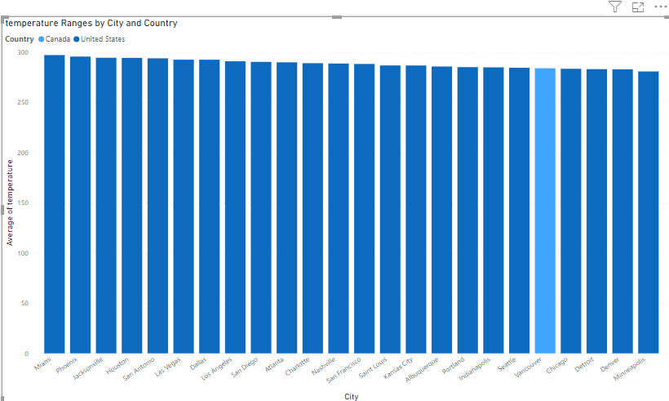
Temperature ranges for cities across different countrie
The temperature range for a city is the difference between the highest and lowest temperatures that are typically experienced in that city throughout the year. For example, the temperature range for New York City is the highest temperature and the lowest temperature that is typically experienced in New York. The temperature range for a city is influenced by a variety of factors, including its latitude, longitude, elevation, and proximity to large bodies of water. Cities that are located at higher latitudes tend to have wider temperature ranges than cities that are located at lower latitudes. This is because cities at higher latitudes receive less sunlight than cities at lower latitudes, which means that they tend to be colder in the winter and warmer in the summer.
Cities that are located at higher elevations also tend to have wider temperature ranges than cities that are located at lower elevations. This is because the air pressure is lower at higher elevations, which means that the air temperature can fluctuate more easily.

Slide 14
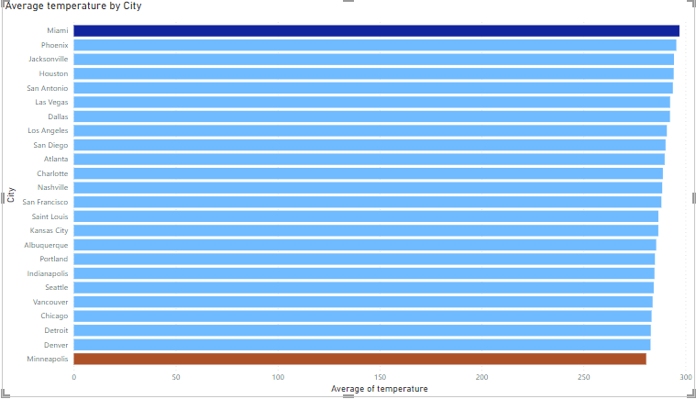
Highlight cities with the highest and lowest average temperatures
This chart is showing average temperature by cities .The highest average temperature is denote as dark blue color and lowest average temperature is denoted as red color. Average temperature in the US varies significantly by region, with colder average temperatures in the north and northeast and warmer average temperatures in the south and southwest. This is due to factors such as latitude, elevation, and proximity to large bodies of water.

Slide 15
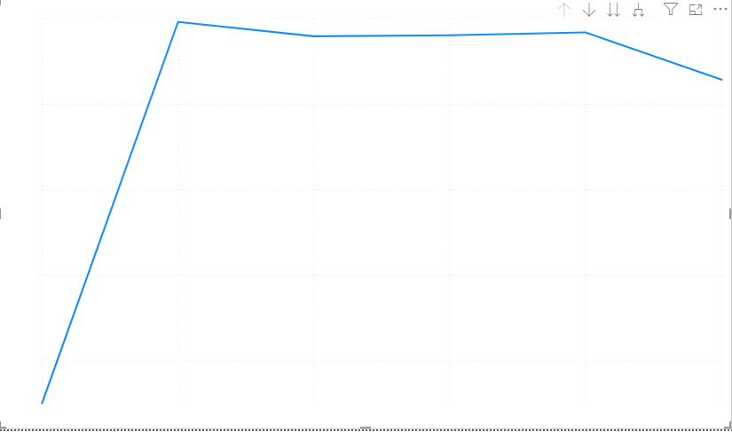
Display the temperature trends over time
The Chart shows the average temperature trend From 2012 to 2017. The trend is upward, indicating that the global average temperature has been increasing over time but In 2017 the Temperature decrease again .

Slide 16
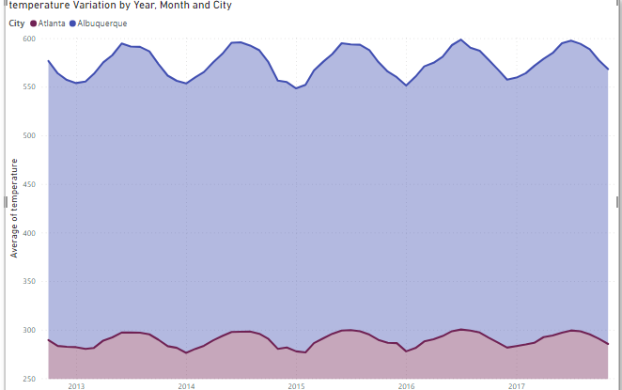
comparing the temperature variations between two selected cities
The Chart shows that the temperature Variation in Altana and Albuquerque varies throughout the year. The highest temperatures in both cities occur during the summer months, while the lowest temperatures occur during the winter months.

Slide 17
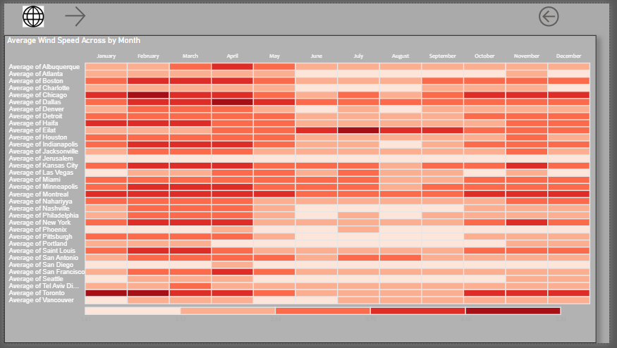
Wind Speed Analysis

Slide 18
average wind speeds across cities for different months of the year
The heatmap is color-coded, with darker colors indicating higher wind speeds. The higher the wind speed, the greater the potential for wind energy generation.
The heatmap shows that the highest average wind speeds are found in the pacific northwest (vancouver, portland, and seattle), the midwest (kansas city, minneapolis, saint louis, and chicago), and the northeast (pittsburgh, toronto, philadelphia, new york, and montreal). These cities are all located in regions with strong pressure gradients, which create high winds.
The lowest average wind speeds are found in the southwest (las vegas, phoenix, and albuquerque) and the southeast (miami). These cities are all located in regions with weak pressure gradients, which create low winds.
The heatmap also shows that the wind speed varies seasonally in most cities. The wind speeds are typically highest in the spring and fall months, when the pressure gradients are strongest. The wind speeds are typically lowest in the summer and winter months, when the pressure gradients are weakest.

Slide 19
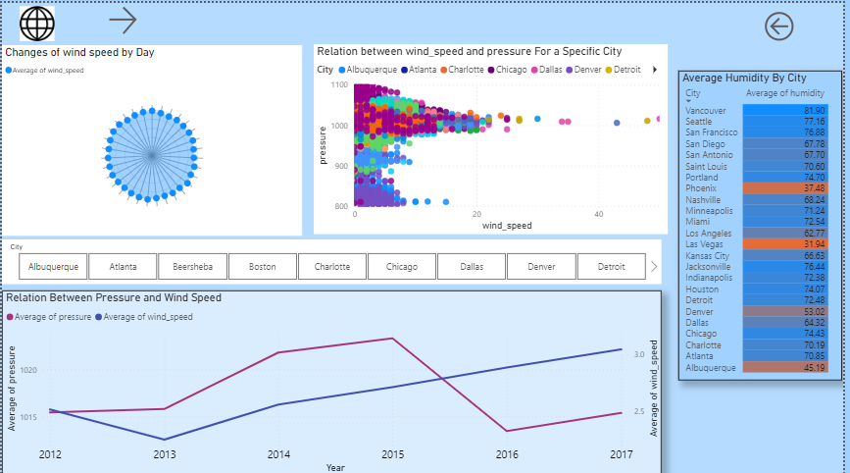
Wind speed and pressure Analysis

Slide 20
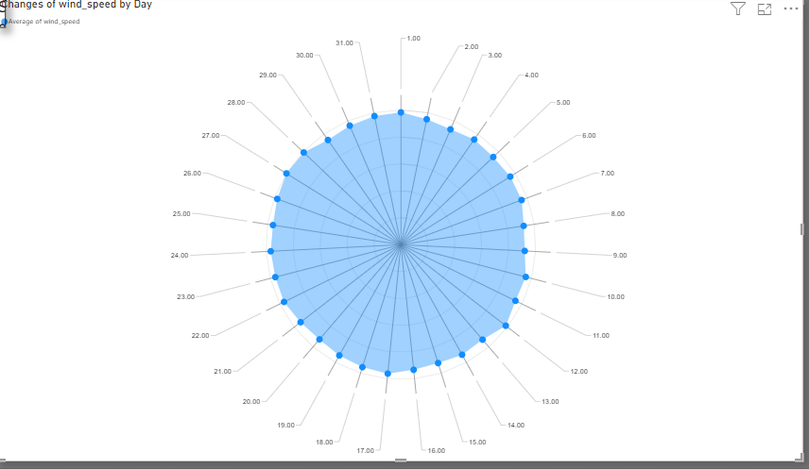
wind speed change over the course of a day
In this chart, the average wind speed varies from day to day. The highest wind speed is on day 27, and the lowest wind speed is on day 9. The wind speed also varies throughout the day. The highest wind speed is typically in the afternoon, and the lowest wind speed is typically at night.

Slide 21
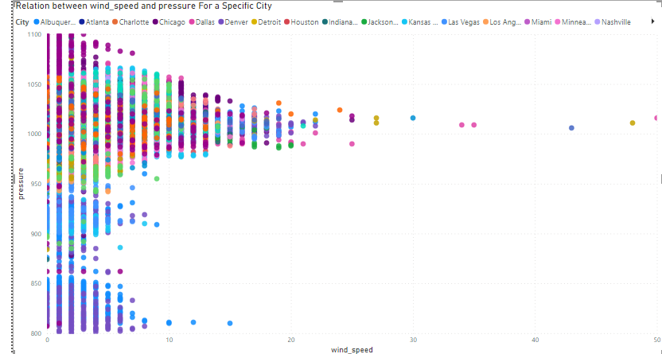
relationship between wind speed and air pressure
The scatter plot shows a clear inverse correlation between wind speed and air pressure. This means that as the air pressure increases, the wind speed decreases, and vice versa. This is because the pressure gradient force, which drives the wind, is inversely proportional to the air pressure.

Slide 22
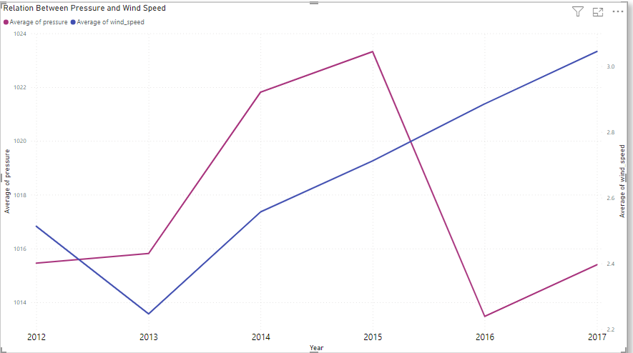
Relationship between wind speed and air pressure for a specific city?
There is a negative relationship between wind speed and air pressure. This means that as the air pressure increases, the wind speed decreases, and vice versa. This is because the pressure gradient force, which drives the wind, is inversely proportional to the air pressure.

Slide 23
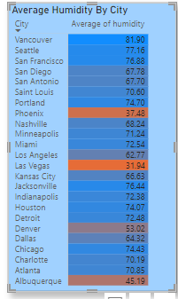
Humidity vary across different cities
I have use matrix table and then use conditional formatting to highlight the highest and lowest values.

Slide 24
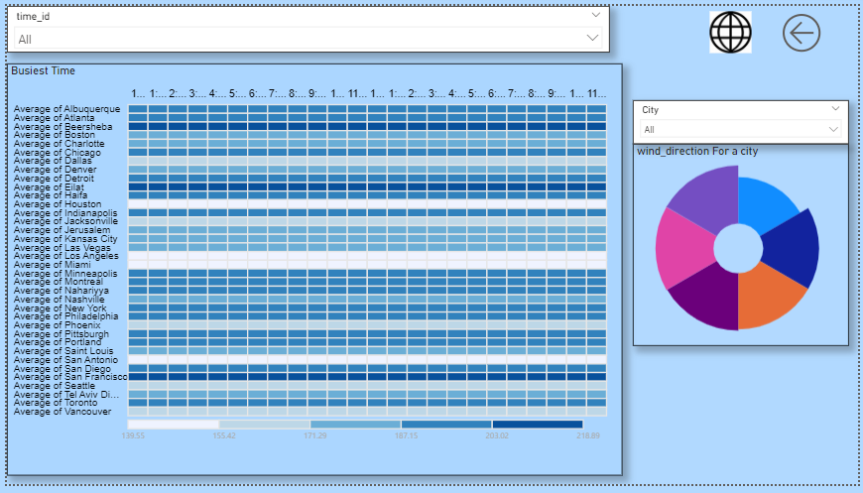
Wind Direction Analysis

Slide 25
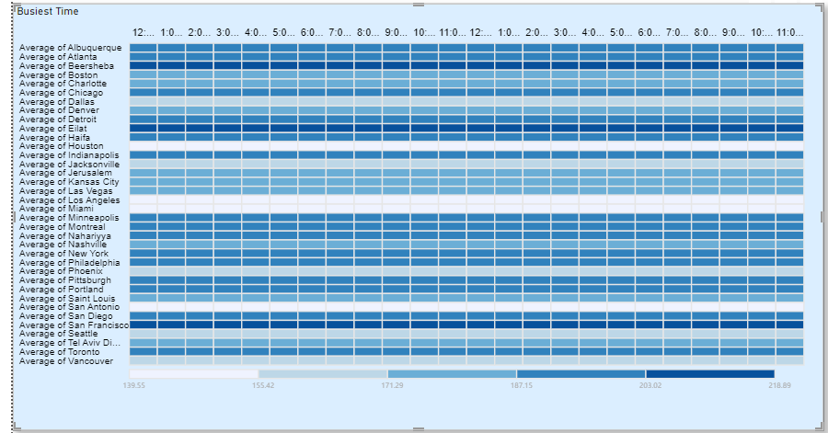
busiest hours
This heatmap is showing the average wind direction by time, the busiest hour of the day is likely to be between 2:00 PM and 3:00 PM.
This is because the wind direction is most consistent and has the highest magnitude during this time, with the average wind direction blowing from the west to the east. This suggests that the sea breeze is strongest during this time, which would make it a good time for wind sports activities or for designing wind turbines and other structures that are exposed to the wind.

Slide 26
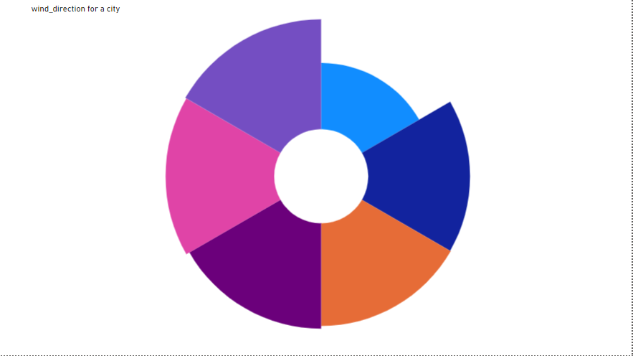
prevailing wind directions for a selected city.
This Chart is Showing the wind Direction from 2012 to 2017 .

Slide 27
EDA PROBLEM STATEMENT

Slide 28
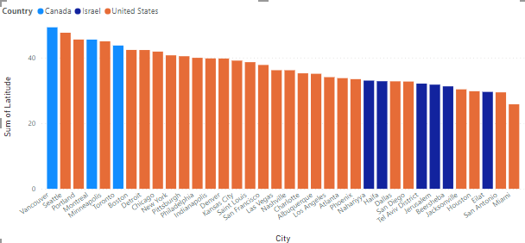
Are there any countries with cities located at extreme latitudes, and how might this impact their climate?
Highest latitude is above 60 for North and below 60 for southern pole but in this dataset Vancouver's latitude, which is relatively high in northern North America, impacts its weather in the following ways: It contributes to a mild and temperate climate with mild winters. Vancouver receives ample rainfall, particularly in the fall and winter. Seasonal temperature extremes are limited, leading to a relatively comfortable climate. The mild weather influences outdoor activities, clothing choices, and energy usage in the city.

Slide 29
Can you identify any clusters of cities with similar latitude and longitude values? What factors might explain these clusters?
City | avg_latitude | avg_longitude
Haifa | 33 | 35
Jerusalem | 32 | 35
Nahariyya | 33 | 35
Tel Aviv District | 32 | 35
The clustering of cities with similar latitude and longitude values in Israel is primarily due to:
Geographic Proximity: Haifa and Nahariyya are coastal cities in the north, while Jerusalem and Tel Aviv District are inland cities in the central part of Israel. Their geographic proximity results in similar coordinates.
Administrative Boundaries: Jerusalem and Tel Aviv District are distinct administrative regions within Israel, and their proximity is reflected in similar coordinates.
Coastal vs. Inland Locations: Coastal cities (Haifa and Nahariyya) share similar coordinates due to their coastline, while inland cities (Jerusalem and Tel Aviv District) also have similar coordinates within their regions.

Slide 30
Are there any correlations between a city's geographical location (latitude and longitude) and its weather attributes, such as temperature or humidity?
Its showing positive relation that means when latitude increase then temperature and humidity also increses and when longitude decreases then temperature and Humidity both decreases

Slide 31
Identify the top three cities with the most frequent occurrence of rainy weather based on weather descriptions. What are the seasonal patterns?
city | Rainy_day_count
Portland | 10994
Vancouver | 10312
Seattle | 9731
The chart shows the number of rainy days in Portland, Vancouver, and Seattle over the past year.
Portland has the most rainy days, with an average of 161 days per year. Vancouver has the second most rainy days, with 155 days per year. Seattle has the fewest rainy days, with 150 days per year.
The chart also shows that the number of rainy days has fluctuated over the past year. For example, Portland had more rainy days in the winter than in the summer. Vancouver had a similar pattern, with more rainy days in the winter and fewer rainy days in the summer.
Overall, the chart shows that Portland is the rainiest city in the Pacific Northwest, followed by Vancouver and Seattle.

Slide 32
Is there a correlation between humidity levels and air pressure? How might this relationship affect weather conditions?
there is weak positive relation between Humidity and pressure

Slide 33
Explore the impact of wind direction on temperature for coastal cities. Are there noticeable patterns
Based on the chart wind speed does have an impact on temperature. The chart shows that as the wind speed increases, the apparent temperature decreases. This is because the wind blows away the warm air layer that surrounds your body, and the colder air that replaces it must be warmed up by your body heat.
The chart also shows that the impact of wind speed on temperature is greater at lower temperatures

Slide 34
Are there specific months when cities experience significant temperature fluctuations? What might explain these variations
There are a few months that face significant fluctuation in temperature according to the chart. These months are:
April
May
October
November
During these months, the temperature can vary by as much as 10 degrees Fahrenheit from day to day. This is because these months are transitional months, meaning that the weather is changing from one season to another. During these months, the jet stream can also be more active, which can lead to more variable weather conditions

Slide 35
Identify periods of extreme weather events, such as storms or heatwaves, by analyzing the time-based data. What patterns emerge?
The Chart provides a list of different weather descriptions and their respective start and end dates. These descriptions are related to various extreme weather events, such as thunderstorms and associated conditions like drizzle or heavy rain. The objective is to identify patterns in the time-based data that can help us understand when these extreme weather events occurred.
From the data, we can see the start and end dates for each weather description. By analyzing this information, we can identify periods when specific weather events occurred. For example, we can determine the duration of a heavy thunderstorm event that started on January 31, 2017, and ended on August 2, 2017.

Slide 36
Are there any notable differences in temperature trends between northern and southern hemisphere cities over the year? How do they relate to seasons?
The Chart shows the average monthly temperature cities in different hemispheres,latitudes less than 0 are generally found in the Southern Hemisphere but in This dataset Latitude Less than and equal to 0 is not present The city in the Northern hemisphere is located in a temperate climate, while the city in the Southern hemisphere is located in a subtropical climate.
The city in the Northern hemisphere has a warm summer and a cold winter. The temperature trend shows that the temperature in the city in the Northern Hemisphere rises from a low in January to a high in July, and then falls again to a low in January. This is because the Northern Hemisphere is tilted towards the sun during the summer months, and away from the sun during the winter months. As a result, the city in the Northern Hemisphere receives more direct sunlight during the summer months, and less direct sunlight during the winter months

Slide 37
Analyze the impact of temperature on energy consumption patterns in cities. Are there noticeable trends or correlations?
Most cities in the dataset have an estimated energy consumption of 0, indicating either extremely low or negligible energy use, likely due to efficient energy practices, alternative energy sources, or minimal energy demand in their specific circumstances.
A few cities like "Las Vegas," "Nashville," and "Phoenix" have values close to zero but represented in scientific notation. These values suggest minimal energy consumption, with the negative sign possibly indicating a slight decrease in energy use over the specified period. However, the values are so small that their significance depends on specific measurement units and context. indicating that temperature anomalies are not significantly affecting energy consumption in these cities.

Slide 38
1. How do specific wind patterns impact air quality and pollution dispersion in urban areas? Analyze wind direction data for insights.
The Chart shows that the most common wind direction category in all of the cities listed is North. This means that the wind blows from north to south more often than in any other direction in these cities.
Here are some specific insights that can be drawn from the output:
The wind direction in Eilat, Israel is variable. This means that the wind does not blow from any one direction consistently in Eilat. This can make it difficult to predict how pollutants will be dispersed in Eilat.
The wind direction in the other cities listed is predominantly North. This means that pollutants emitted from sources in the northern part of these cities are likely to be transported to the southern part of the cities

Slide 39
1. Explore whether wind speed and direction influence the frequency and severity of weather-related events (e.g., hurricanes, storms) in coastal cities.
This scatter plot is showing a negative correlation between wind speed and wind direction frequency in coastal areas suggests that certain combinations of wind conditions occur less frequently. This can influence the frequency and severity of weather events like storms or heavy rain. For instance, less common wind conditions may lead to fewer weather events, and when they do occur together, they could be more severe. Understanding this correlation is crucial for better forecasting and preparedness for extreme weather conditions in coastal regions.

